Slide 1
Predictive Maintenance in Smart Factories Using SAP Analytics Cloud: A Data-Driven Approach to Minimize Downtime and Optimize Maintenance Costs
Course Name: Smart Factories 4.0
Professor Name: Prof. Dr. Christian Leubner
Presented By: Md Abdullah Al Noman
Semester: SoSe25
Fachhochschule Südwestfalen

Slide 2
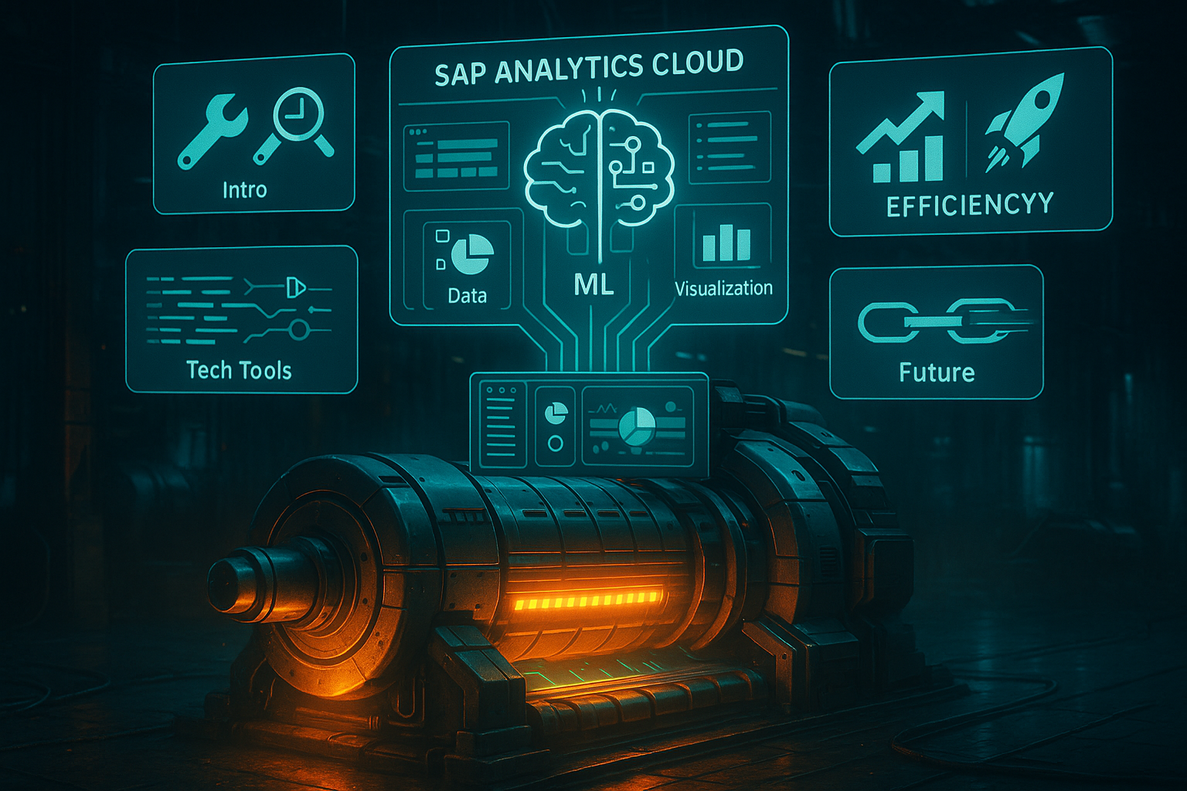
CONTENTS
Introduction – Why Predictive Maintenance?
Solution Framework using SAP Analytics Cloud (SAC)
Technical Process & Tools
Business Impact
Conclusion & Future Vision

Slide 3
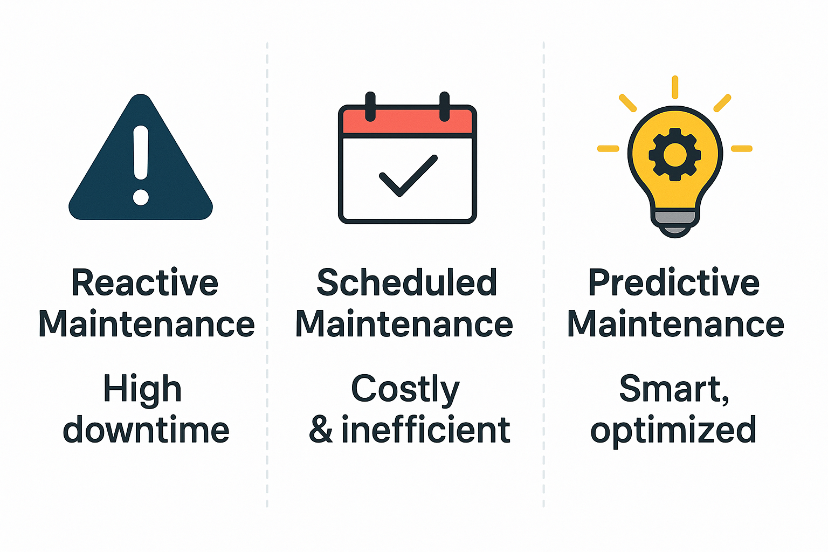
Why Predictive Maintenance?
Unplanned downtime costs manufacturers around $260,000 per hour (Deloitte, 2023).
Traditional maintenance is reactive or scheduled not efficient.
Predictive maintenance enables proactive equipment monitoring using data.

Slide 4
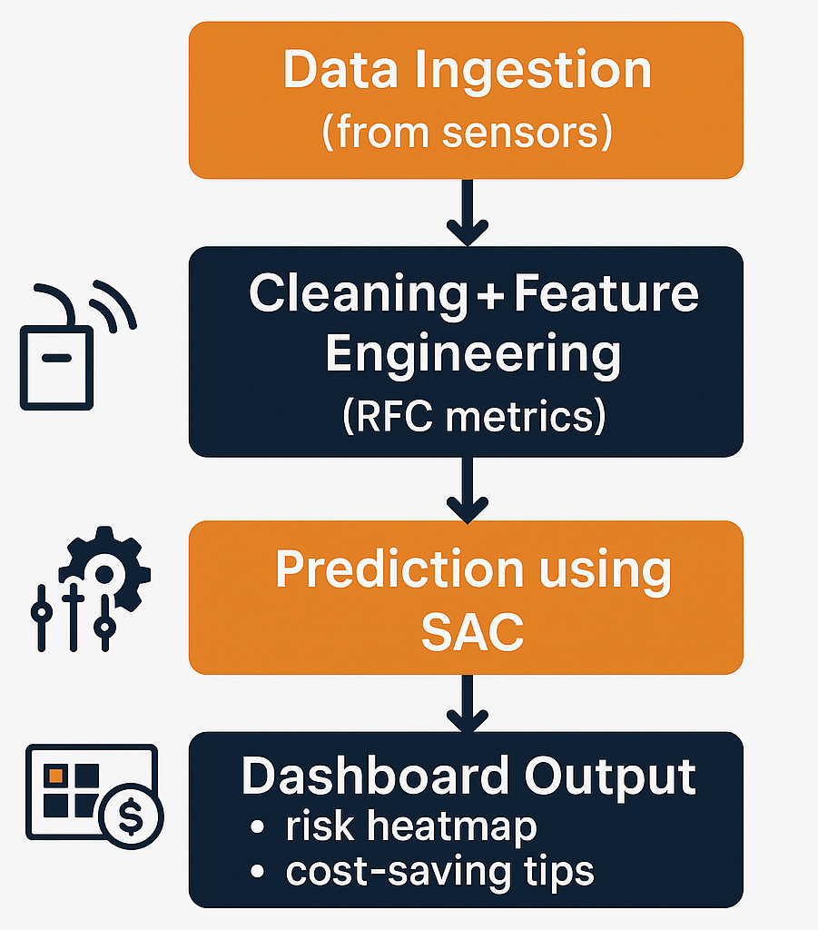
Solution Framework using SAP Analytics Cloud (SAC)
Uses Kaggle dataset with 10,000+ industrial IoT sensor records. SAP Analytics Cloud enables: Clustering machines by risk (High, Medium, Low). Predictive modeling with Smart Predict (e.g., Random Forest). Visualization via interactive dashboards.

Slide 5
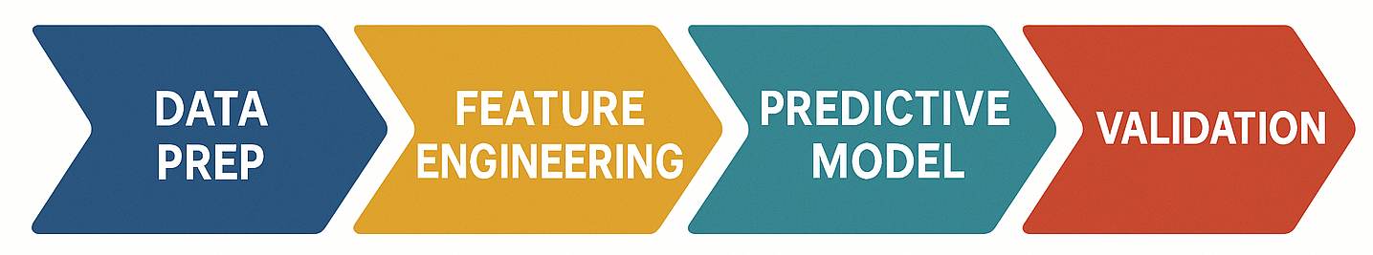
Technical Process & Tools
Data Cleaning: Remove outliers, handle missing values.
Feature Engineering: Recency, Frequency, Criticality metrics.
Modeling: SAC’s Smart Predict.
Validation: Alerts for >70% failure probability.

Slide 6
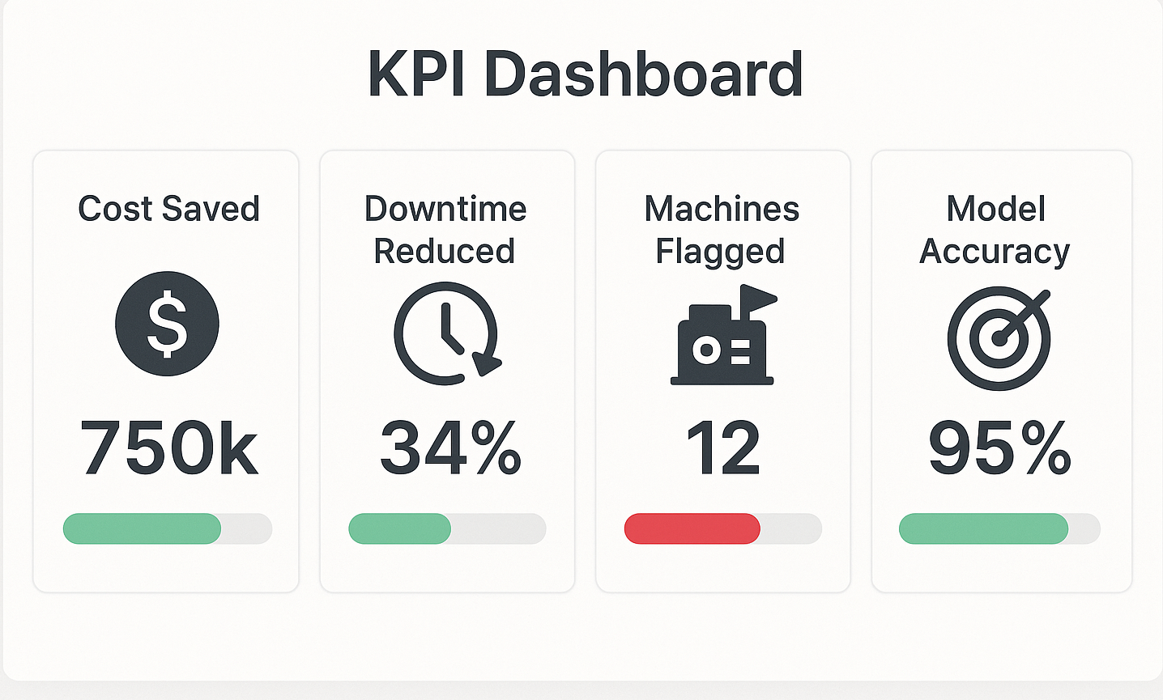
Business Impact
1
12% of machines identified as high-risk.
2
Estimated $180,000/year cost saving for mid-size factory.
3
Downtime reduced by 30% (McKinsey, 2022).
4
Enhances sustainability (less energy/waste).

Slide 7
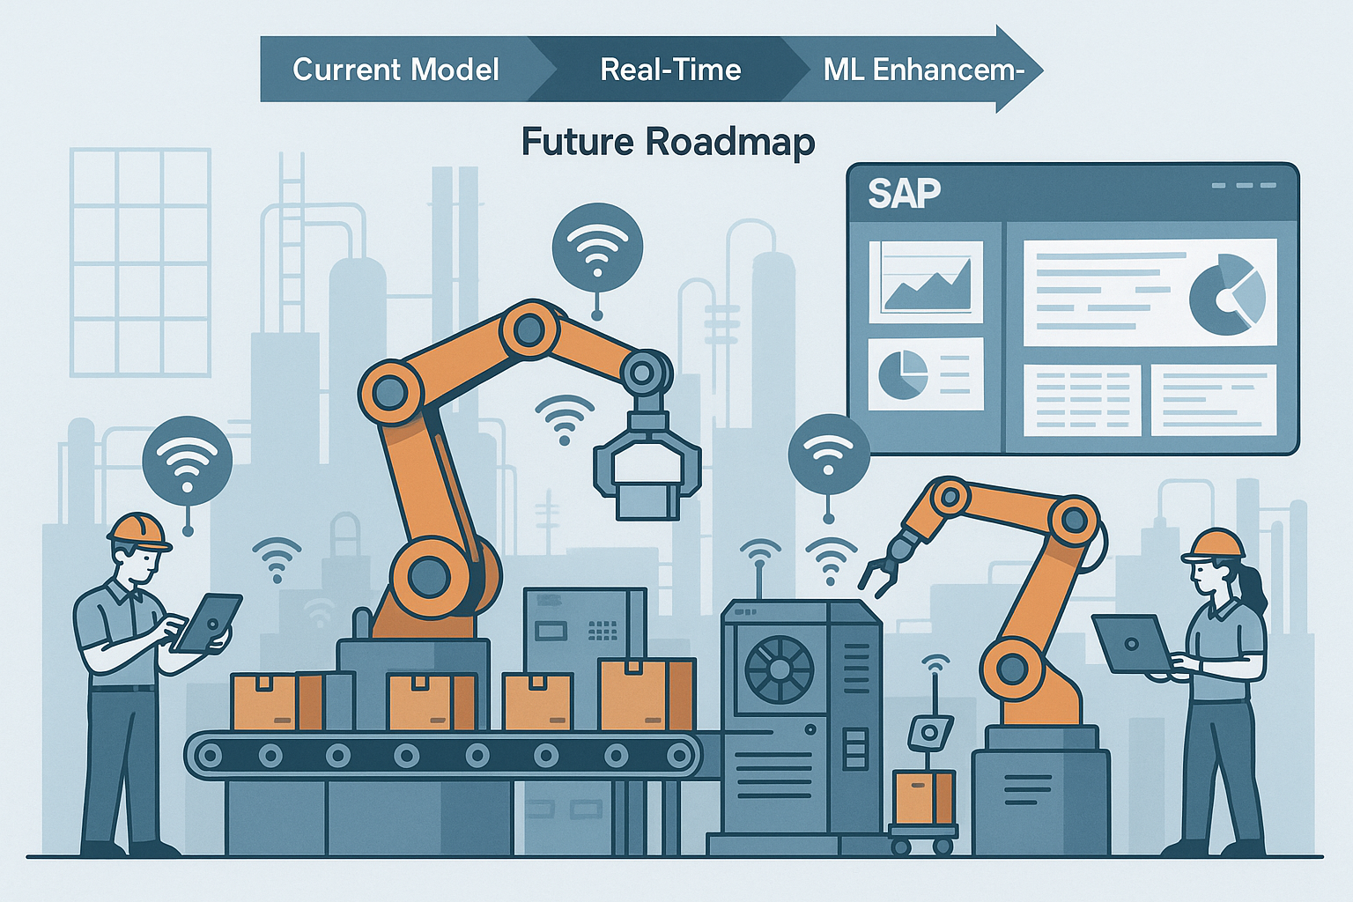
Conclusion & Future Vision
SAC empowers smart decision-making in Industry 4.0.
Scalable with SAP S/4HANA integration.
Future scope: Real-time IoT data + advanced ML models.
THANK YOU !!

